Slide 1
Maze Runners: Providing Excellence in School Based Mental Health Delivery
Connie Rodriguez, LPA, LMFT, LSSP
Dallas Independent School District
Director of Psychological Social Services and HEP
TASP Summer Institute June 2015

Slide 2
Texas
7 million children under the age of 18
1.4 million with mental illness, all income strata (MHA)

Slide 3
Dallas County
City of Dallas: Families with children 5-17 years old 37.7% live below poverty level
State poverty level for families is 24.8%
Poverty level by family type
Married couple 35.2%
Male, no wife 13.1%
Female, no husband 51.7%
From: www.city-data.com/poverty/poverty-Dallas-Texas

Slide 4
Dallas Independent School District
District 2014-15
Student Demographics
160,253 students
More than 70 languages
224 schools
384 square miles
89% Free & Reduced Lunch
70% Hispanic
23% African American
5% White
1.3% Asian
.3% Native American

Slide 5
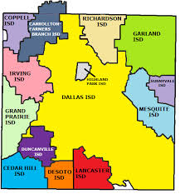
Dallas ISD & Surrounding School Districts

Slide 6
Dallas ISD Organizational Support
School Leadership
Student Services Division
Psychological & Social Services
Youth & Family Centers
Counseling Services
Health Services

Slide 7
Comprehensive System Learning Support
Resources, strategies and practices that provide
physical … social … emotional … intellectual supports
Enables all students for success
Addresses barriers to teaching and learning
Re-engages students in the learning process
From: www.smhp.psych.ucla.edu

Slide 8
Student Learning Supports
Campus/Class RTI
Crisis Assistance & Prevention
Student & Family Intervention
Support for Transitions
Home & Family Engagement
Expected Outcomes
Address barriers to learning
Make resources available to students & Families
Increase graduation rates
Increase engagement
Improve attendance
Decrease discipline referrals

Slide 9
Streamline Process of Engagement
District level created “Partnership Agreement” process to assist community partners access to campuses
PSS Department worked with DISD Legal to develop generic contracts with Psychology & Social Work graduate programs wanting to place practicum students for field placements
YFC Department established Parkland Hospital agreement to provide medical teams for each center
Health Services established agreements for vision/eyeglasses & vaccinations

Slide 10
Psychological Social Services & Homeless Education Program
PSS staff provide behavioral health services to general education students and their families
Counseling services
Case management
Consultation
Training/Education
HEP staff provide services that establish stability for children & youth in transition
Offers Mckinney-Vento training to shelters, parents, community organizations and district staff
Offers uniforms, toiletries, other donated items

Slide 11
Psychological Social Services & Homeless Ed.
PSS staff
Staff assigned by geographic quadrants and high school feeder patterns
8 crisis response teams with 2 teams per quadrant
Suicide/violence risk assessments, safety planning
Assigned staff Liaison with Juvenile Department
Homeless Education Program
M/V training & consultation
7 drop-In centers at high schools throughout the city
Transportation assistance
Coordinate/provide youth development with city shelters

Slide 12
Data for PSS

Slide 13
Homeless Education Program
Outreach Provided
FOOD | 61
COATS | 19
SHOES | 55
BACKPACKS | 242
HYGIENE | 42
UNIFORMS | 313
HOLIDAY ASSISTANCE | 46
MV students served | 860
As of 1/30/15 Homeless enrollment 2100 students, this is a 19% increase from last year
Bus passes 76
Out of district transport 50

Slide 14
School Based Mental Health - Staffing
PSS/HEP
LSSP-LMSW-LCSW-LP
224 campuses, 7 HEP Drop-In Centers
YFC
LCSW-LPC-LP
12 school-based centers
Counseling Services
377 counselors
224 campuses

Slide 15
Youth & Family Centers
Created a partnership to promote and ensure physical and mental health care
Utilized an integrated approach to help students achieve optimal health and maximize school performance.
Dallas ISD and Parkland Health and Hospital System have combined resources to provide cost-effective, accessible, quality physical and mental health care services.
Expansion began in 1993 and has grown to 11 YFC centers
School district provides counseling and psychiatry services
Child psychiatrist
Center Manager and 2 full-time clinical staff (LCSW, LPC, LMFT, LP)
Part-time clinicians

Slide 16
Youth & Family Center 2013-14 Data
5500 students and families served
40,182 services ( counseling, medication management, psychiatric evaluations, etc.)

Slide 17
School Based Mental Health
Intensive
YFC/PSS
Tier 3
Targeted
PSS
Tier 2
Universal
PBIS/Counseling Services
Tier 1

Slide 18
Tier 1 Universal Supports
School –Based Mental Health

Slide 19
Universal Supports
Psychological & Social Services & HEP
Counseling Services
Training on Suicide & Violence risk assessment to school counselors
Campus staff training on Suicide Risk Factors
Serve as PBIS/Foundations Coaches for campuses
Participate on Student Support Teams
Classroom guidance
Student Support Team member
Conduct Suicide & Violence Risk Assessments
Chair SST teams

Slide 20
Targeted Supports Tier 2
School-based Mental Health

Slide 21
Targeted Supports
Psychological Social Services & HEP
Youth & Family
Individual & Group counseling
Mindfulness meditation- individual & classroom
Transition services for students returning to campus from DAEP, JJAEP, Hospital Homebound, Community placements
FBA and BIPs
504 mtgs
Individual, group and family counseling
Psychiatric Evaluations
Medication management

Slide 22
Intensive Tier 3
School-based Mental Health

Slide 23
Intensive supports
Psychological & Social Services
Youth & Family Center
Crisis response teams
Postvention services
High risk suicide and violence risk assessments
Collaborate with Psychiatric hospital staff when hospitalization is needed
Psychiatry
Medication management
Individual & family counseling

Slide 24
Dallas ISD School Based Mental Health Model

Slide 25
Psychological & Social Services
Staff Composition
Assignment
44 Total staff
24 LSSP’s/6 LP
20 SW/ 6 LCSW
4 Pre-Doctoral Interns
1-4 Psychology & SW Practicum Students
224 campuses over 384 square miles
Geographical assignments by High School Feeder Pattern
On average 5 campuses/staff
Campus size is also a factor

Slide 26
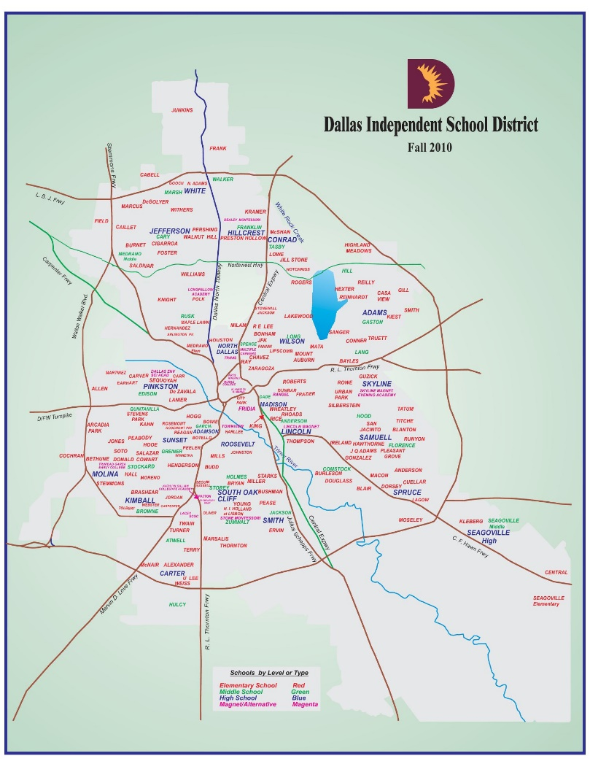
Dallas ISD Map

Slide 27
PSS work plans
Meeting with campus leadership (Principal, AP, Nurses, Counselors) to discuss campus needs
Discuss PSS programs & services available
Establish a school schedule that coincides with SST meeting days
Establish contact with Special Education diagnostician or LSSP assigned to campus

Slide 28
Crisis Response Services
Individual CrisIs
Campus/community Crisis
Campus counselors conduct initial risk assessment
District policy & procedures require parent notification
PSS provides assistance on High Risk cases
PSS may assist with student Safety Planning
Deaths, public health incidents, neighborhood violence, etc. that impact 1 or more classrooms
All PSS staff are assigned to rapid response teams
Team members all have roles & responsibilities
Members trained in Psychological First Aide

Slide 29
Youth & Family Centers and Crises
Provide follow-up care to students & families after the crisis has been addressed
Collaborate with Counseling Services, PSS and other district departments to help students access to other district programs & services
504
Special education
Hospital homebound
Truancy

Slide 30
YFC Services
Dallas ISD Refugee Program provides services to refugee students and their families
Orientation to public education
Family involvement activities summer enrichment programs
Mental health care
Translation/interpreting services
Physical Health
Support Services

Slide 31
Referrals
School Based Model

Slide 32
Service Provision
Wellness is more than the absence of illness.
disorders exist on a continuum, rather than being simply a matter of having/not having.
even when illness is present to a greater or lesser degree, individuals can experience more or less well-being—for instance, a sense of competence, purpose, and optimism.
illness-free individuals can struggle with the absence of these attributes of “flourishing.”
Wellness—is a resource—one that is developed, nurtured, drawn-upon, and replenished throughout life.
From: Child Trends. Are The Children Well

Slide 33
Initiation of Referrals
PSS
YFC
Campus- SST, Teacher, Administrator, Nurse, Counselor
Parent
Student
JJAEP
DAEP
Campus – SST, Nurse, Counselor
Parent
Student
PSS

Slide 34
Website Links
http://learn.nctsn.org/course/index.php?categoryid=11
www.smhp.psych.ucla.edu
http://csmh.umaryland.edu/index.html
http://www.pbis.org/school/tertiary_level/wraparound.aspx

